Slide 1
UE22CS320A– Project Phase – 1
End Semester Assessment
Project Title : “DETECTION AND MITIGATION OF REPLAY ATTACKS ON CCTV SYSTEMS”
Project ID : 49
Project Guide : Dr. Sarasvathi V
Project Team : Soumya Ranjan Mishra(PES2UG22CS571)
Suhas Venkata Karamalaputti(PES2UG22CS590)
Shreyas S(PES2UG22CS540)
Mohit S(PES2UG22CS320)

Slide 2
Agenda
Introduction and Motivation
Problem Statement
Abstract and Scope
Suggestions from Review – 1
Research / Technology gap and Challenges
Objectives
Literature Survey / Existing System
Dataset exploration
References

Slide 3
Introduction and Motivation
In a replay attack, hackers intercept and capture video footage or commands from CCTV systems, then retransmit this data later. This allows them to trick the system into showing old footage as live, bypassing real-time monitoring. Replay attacks can:
Bypass Real-Time Surveillance: Replay old footage to hide current activities.
Create Security Blind Spots: Undetected intrusions in sensitive areas (e.g., banks, data centers).
Manipulate Evidence: Tamper with footage used in legal investigations.
Exploit Access Control Systems: Replay authorized entry footage to gain unauthorized access.
Target Legacy Systems: Older systems with weak security are more vulnerable.

Slide 4
MOTIVATION
Replay attacks on CCTV systems exploit vulnerabilities by retransmitting recorded footage to bypass live monitoring. These attacks create security blind spots and can manipulate access control, leading to real-world security breaches, as seen in the past:
2019 Chinese Traffic Light Manipulation: In China, hackers successfully manipulated traffic lights by replaying footage of a green light, causing traffic disruptions and potential safety hazards. This incident demonstrated the potential consequences of replay attacks on critical infrastructure.
2020 Indian Smart City Surveillance Compromise: Reports emerged of replay attacks targeting smart city surveillance systems in India, leading to concerns about the security of sensitive data and potential misuse of footage.
In 2020, a class-action lawsuit was filed against Ring LLC after a series of incidents where hackers gained unauthorized access to Ring cameras, including incidents where they harassed and threatened users. One notable case involved a hacker taunting an 8-year-old girl through her bedroom camera. The lawsuit accused Ring of negligence, citing a lack of security measures such as two-factor authentication, which could have prevented these breaches.
Another example of cyber-enabled, violence and confidentiality harm can be found in a UK police report of someone who stalked his ex-partner through the app companion of an ELAN smart home system (UK police report).

Slide 5
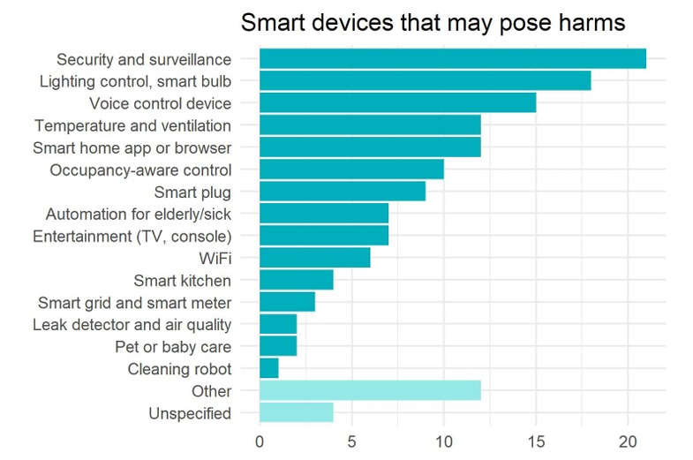
The most referenced devices in our systematic review were security and surveillance systems (21, 33%), followed by lighting systems and smart bulbs (18, 28.6%) and voice control devices (15, 23.8%). For instance, identifies user behaviour from traffic data of smart cameras, and apply graph-based mechanisms to analyse traffic between Google Home smart speaker and TP-LINK light bulbs and identify vulnerabilities. Before we had seen several exemplar cases of harms related to security systems, such as the UK court case that concluded smart doorbell cameras invade neighbor’s privacy, and the USA court case about home CCTV disabled by Mirai malware.

Slide 6
Replay attacks in urban surveillance and traffic cameras, pose significant security risks. These attacks involve intercepting and retransmitting legitimate video footage to mislead surveillance systems, potentially causing unauthorized access or misinterpretation of events. Real-Life Examples:
Unauthorized Access: In 2021, a replay attack on a traffic camera system allowed attackers to gain unauthorized access to restricted areas, posing security threats to critical infrastructure.
Misleading Evidence: In 2020, a replay attack on traffic cameras was used to create misleading evidence in a legal case, highlighting the need for robust detection mechanisms to ensure the integrity of surveillance data

Slide 7
Problem Statement
CCTV systems are essential for modern surveillance, yet they are vulnerable to replay attacks, where attackers intercept and resend legitimate data, leading to unauthorized actions. These attacks exploit the lack of robust security measures, particularly in communication protocols that fail to implement strong authentication and encryption​.
The consequences can be severe, including unauthorized access, manipulation of recorded footage, and compromised integrity of surveillance data. Industries such as banking and transportation face significant risks, as compromised CCTV can undermine public safety and trust​.
Despite existing security measures, there remains a gap in addressing replay attack vulnerabilities. This project aims to develop an AI-based detection and response system to enhance the security of CCTV networks against these specific threats, ensuring a more reliable surveillance infrastructure

Slide 8
Abstract and Scope
CCTV systems are vital for surveillance across sectors like banking, transportation, healthcare, and public safety. However, they face growing cyber threats, especially replay attacks, where intercepted video or data streams are retransmitted to deceive the system. This leads to unauthorized access, footage tampering, and compromised surveillance integrity, exposing the need for robust security enhancements. This project proposes an AI-based detection and response system to mitigate replay attacks by integrating machine learning and cryptographic security measures.
Key components include:
- AI-Powered Anomaly Detection: Identifying timestamp and frame inconsistencies in video streams.
- Secure Communication Protocols: Encrypting data and verifying stream authenticity.
- Real-Time Automated Response: Alerting admins, isolating compromised devices, and blocking threats.
Modular Design: Seamlessly integrating with existing infrastructures. The system undergoes vulnerability assessments, machine learning model training, and rigorous testing to ensure effectiveness, scalability, and ease of use.
Expected outcomes include improved replay attack detection, enhanced CCTV security, and greater trust in surveillance technologies, making this a significant step towards adaptive, secure surveillance solutions.

Slide 9
Suggestions from Review - 1
The panel members consisted of Dr. Sarasvati V, Dr. Clara Kanmani and Prof. Shruthi L suggested us the following:
Focus on finding more relevant research papers.
Coming up with a plan on demonstration.
What is the use case we are planning to work with initially.
We were also asked to find out the relevant sources for datasets.

Slide 10
Challenges and Research Gap
After going through multiple research papers and online references we found out that:
Not focused on real time streaming data.
Also we plan on implementing reinforcement learning as an add on so that our AI can learn with every incident that is captured by the cameras.
Non-existent incident response system

Slide 11
Objectives
The primary objective of this project is to design and implement an AI-powered system to detect and mitigate replay attacks in CCTV surveillance networks. The system aims to ensure the authenticity and reliability of video footage, protecting critical infrastructures and enhancing trust in modern surveillance systems. To achieve this overarching goal, the following specific objectives have been identified:
Develop an AI-Based Detection Framework
Design and train machine learning models capable of identifying anomalies in video streams that are indicative of replay attacks.
Leverage advanced algorithms to differentiate between live footage and replayed or tampered video data.
Implement Real-Time Monitoring and Alerts
Enable continuous, real-time monitoring of CCTV feeds for proactive threat detection.
Generate automated alerts to notify security personnel of potential replay attacks, ensuring swift responses.

Slide 12
Objectives
Enhance Data Integrity in Surveillance Systems
Implement mechanisms to validate the integrity of video streams by analyzing timestamps, environmental contexts, and camera metadata. Protect surveillance data from tampering to ensure its reliability for law enforcement, legal proceedings, and operational decision-making. Ensure Adaptability in Modern surveillance. Also Employ AI-driven analytics to optimize resource allocation, such as focusing monitoring efforts on high-risk zones.
Minimize False Positives and False Negatives
Ensure the accuracy of the detection system by reducing false alarms and missed detections.
Promote Automation in Cybersecurity Responses
Develop automated responses to mitigate replay attacks, such as isolating compromised cameras or reconfiguring network protocols. Ensure that these responses are both effective and minimally disruptive to ongoing surveillance operations.

Slide 13
Literature Survey/Existing System
Details of Paper- Title, author, conference /Journal | Methodology Used | Result | Limitations
Title: “A Data-Driven Framework for Verified Detection of Replay Attacks on Industrial Control Systems” Authors: Sara Gargoum, Negar Yassaie, Ahmad W. Al-Dabbagh, Chen Feng Journal Paper[2024] | The paper proposes a two-stage detection and verification framework for detecting replay attacks in industrial control systems. The methodology includes: Real-time monitoring of sensor data using matrix profile-based change-point detection. Spatio-temporal feature extraction using short-time Fourier transform (STFT) to create spectrograms. ConvLSTM-AE (Convolutional Long Short-Term Memory Autoencoder) to verify replay attacks through reconstruction error from normal data. | The proposed framework successfully detects and verifies replay attacks in real-time across different scenarios. Demonstrated effectiveness using a Tennessee Eastman Process simulation model, with results showing a 100% verification rate for replay attack detection. Low false alarm rate and detection delay metrics, proving the reliability of the system. | The method assumes access to normal/nominal data for training, which could be challenging in real-world systems where attack data is scarce. The second stage of the framework (replay attack verification) is computationally expensive, which might be a limitation for large-scale deployments. The proposed approach may miss some rare attack scenarios, especially if the system is overfitted to specific attack patterns.

Slide 14
Details of Paper- Title, author, conference /Journal | Methodology Used | Result | Limitations
Title: “An Enhanced Deep Learning Approach for Preventing Replay Attacks in Wireless Sensor Networks” Author(s): Rajaram Pichamuthu, Sathishkumar A., Khadirkumar N. Journal: Solid State Technology, Volume 63, Issue 4 (2020) | Proposed a hybrid approach combining LSTM (Long Short-Term Memory) and decision trees for detecting replay attacks in WSNs. Utilized features such as packet length and group delay to identify anomalies. Performed Gaussian blur and FFT on multimedia packets for noise reduction and feature extraction. Trained on the ASV Spoof 2017 dataset. | Achieved 0% error rate on both the development and evaluation sets for packet replay detection. Decision trees yielded high precision and detection rates, with replay attacks having 99% True Positive Rate (TPR) and 0% False Positive Rate (FPR). | Focused solely on Wireless Sensor Networks, limiting direct applicability to CCTV systems. The approach requires significant computational resources, which may not be feasible for real-time or resource-constrained environments. Limited evaluation dataset; lacks testing on diverse, real-world attack scenarios.

Slide 15
Details of Paper- Title, author, conference /Journal | Methodology Used | Result | Limitations
Title: “Replay Attack Detection for Cyber-Physical Control Systems: A Dynamical Delay Estimation Method” Author(s): Dong Zhao, Bo Yang, Yueyang Li, Hui Zhang Conference/JournalIEEE Transactions on Industrial Electronics[2024] | Proposed a Dynamical Delay Estimation (DDE) method combining system dynamics and data-driven approaches. Used sliding window techniques to estimate and track delays between system inputs and outputs. Integrated a randomized algorithm to initialize delay estimations and adopted a window-adaptive strategy for real-time detection. Focused on time-series correlation and changes in delay to detect anomalies indicative of replay attacks. | Successfully detected replay attacks in a distillation column experiment with high accuracy (90.7%).Compared favorably against other anomaly detection methods like SVM, Isolation Forest, LOF, and LSTM in terms of precision (99.8%), recall (83.9%), and F1-score (91.2%).Demonstrated robustness against signal noise and network-induced disruptions. | Relies on the assumption that control system dynamics remain constant during operation, which may not hold for all systems. Initial delay range estimation requires domain-specific knowledge or offline learning from large datasets. The computational complexity is reduced compared to deep learning models, but the method's adaptability to systems with heterogeneous or non-stationary dynamics remains a challenge. Detection depends on the accuracy of predefined delay thresholds, potentially limiting flexibility in diverse scenarios.

Slide 16
Details of Paper- Title, author, conference /Journal | Methodology Used | Result | Limitations
Title: “Lightweight 3D-StudentNet for defending against face replay attacks” Author(s): Preethi Jayappa Seegehalli, B. Niranjana Krupa Journal: Signal, Image and Video Processing (2024)] | - Proposed 3D-ArrowNet, a deep neural network leveraging spatial and temporal features.- Introduced 3D-StudentNet, a lightweight version using knowledge distillation to reduce computational complexity.- Tested on Replay-Attack, Replay-Mobile, and combined datasets.- Utilized HSV color space for input to enhance color texture differentiation between real and spoof attacks. | - Achieved 100% accuracy on Replay-Attack dataset.- Achieved 99.66% accuracy with ACER (Average Classification Error Rate) of 0.45 on Replay-Mobile dataset.- Combined dataset accuracy: 99.23%. | - High computational complexity of the 3D-ArrowNet due to large kernel sizes (e.g., 11×11×11).- The approach is computationally intensive for real-time applications.- Limited focus on datasets specific to facial replay attacks; lacks evaluation on broader datasets like those for CCTV systems.- Potential generalization issues for novel or unseen attack types, such as 3D mask attacks or partial face region attacks.

Slide 17
Details of Paper- Title, author, conference /Journal | Methodology Used | Result | Limitations
Title: Sequential Detection of Replay Attacks Author: Arunava Naha, André Teixeira, Anders Ahlén, Subhrakanti Dey IEEE Conference: Transactions on Automatic Control, Vol. 68, No. 3, March 2023 | CUSUM Detection: Introduced a scheme using Cumulative Sum (CUSUM) tests for replay attack detection. Statistical Analysis: Employed joint statistical analysis of innovation and watermarking signals. KLD Derivation: Derived Kullback–Leibler Divergence (KLD) for joint distributions before and after the attack. Optimization Technique: Presented a method to optimize watermarking signal variance to maximize KLD. Delayed Watermarking: Proposed a strategy using delayed watermarking signals to improve detection in systems with a relative degree greater than one. | Achieved reduced detection delay compared to state-of-the-art methods like Neyman–Pearson-based χ² detectors. Improved detection efficiency by optimizing watermarking signals for minimal cost. Demonstrated effectiveness through simulations with multiple system models, including linear time-invariant and time-varying systems. | Assumes attacker does not access watermarking signals. Some models rely heavily on system-specific parameters, which might limit generalizability. Techniques like suboptimal CUSUM tests may lead to non-optimal detection in certain scenarios. High relative-degree systems may experience reduced KLD, necessitating additional measures for improvement.

Slide 18
Details of Paper- Title, author, conference /Journal | Methodology Used | Result | Limitations
Title: Optimal Chi-squared Detector of Replay Attacks on Cyber-Physical Systems Authors: Aaqib Patel, Md. Zafar Ali Khan Conference: 2021 9th International Conference on Systems and Control (ICSC) | Designed an optimal chi-squared detector by adding random authentication signals to control inputs. Optimized the covariance matrix of the authentication signal to maximize detection performance while controlling false alarms. Conducted hypothesis testing to distinguish between normal and replayed data based on test statistics. | Improved detection performance compared to suboptimal methods by optimizing the covariance matrix. Demonstrated through simulations that the optimized approach achieves higher detection probability with lower false alarms, even under tight constraints. | Assumes the attacker has limited ability to anticipate or bypass random signals. The method relies on strict assumptions about system stability and noise characteristics. May not be directly applicable to non-linear or dynamic systems without significant adaptation.

Slide 19
Details of Paper- Title, author, conference /Journal | Methodology Used | Result | Limitations
Title: Reinforcement Learning Solution for Cyber-Physical Systems Security Against Replay Attacks Authors: Yan Yu, Wen Yang, Wenjie Ding, Jiayu ZhouJournal IEEE Transactions on Information Forensics and Security, Vol. 18, 2023 | Proposed a model-free reinforcement learning-based framework for detecting replay attacks. Formulated the detection as a Markov Decision Process (MDP). Utilized Q-learning to optimize attack-defense strategies dynamically. | Demonstrated high detection accuracy and adaptability to evolving attack strategies. Enhanced estimation performance in CPS under replay attacks. Showed robustness against intelligent attackers in simulations. | Focused on Cyber-Physical Systems (CPS), requiring adaptation for CCTV systems. Computational complexity in real-time large-scale networks. Assumes knowledge of system parameters for attack-defense interactions.

Slide 20
Details of Paper- Title, author, conference /Journal | Methodology Used | Result | Limitations
Title: A Hybrid Deep Learning Approach for Replay and DDoS Attack Detection in a Smart City Authors: Asmaa A. Elsaeidy, Abbas Jamalipour, Kumudu S. Munasinghe Journal: IEEE Access, Vol. 9, 2021DOI: 10.1109/ACCESS.2021.3128701 | Proposed a hybrid deep learning model combining Restricted Boltzmann Machines (RBM) for feature learning and CNN for classification. Used time-series data from smart city systems (environmental, river, soil) and simulated replay/DDoS attacks. | Achieved high accuracy: 98.37% (environmental), 98.13% (river), and 99.51% (soil datasets). Outperformed other models in detecting attacks effectively. | Focused on IoT-based smart city datasets; may need adaptation for CCTV systems. Computationally intensive, requiring powerful hardware for real-time application.

Slide 21
Dataset Exploration
Link 1: Highway Traffic Videos Dataset
Source – Kaggle
Size – 92.45 MB
References - A. B. Chan and N. Vasconcelos, "Probabilistic Kernels for the Classification of Auto-Regressive Visual Processes". Proceedings of IEEE Conference on Computer Vision and Pattern Recognition, San Diego, 2005.
Link 2: Replay-Attack — EN
Source – Idiap
Size – 90 MB
References - A. B. Chan and N. Vasconcelos, "Classification and Retrieval of Traffic Video using Auto-Regressive Stochastic Processes". Proceedings of 2005 IEEE Intelligent Vehicles Symposium, Las Vegas, June 2005.
Link 3: Urban Tracker: Suivi multiobjets en milieu urbain
Source – Urban Tracker
Size – 120 MB
References - Jodoin, J.-P., Bilodeau, G.-A., Saunier, N., Urban Tracker: Multiple Object Tracking in Urban Mixed Traffic, Accepted for IEEE Winter conference on Applications of Computer Vision (WACV14), Steamboat Springs, Colorado, USA, March 24-26, 2014

Slide 22
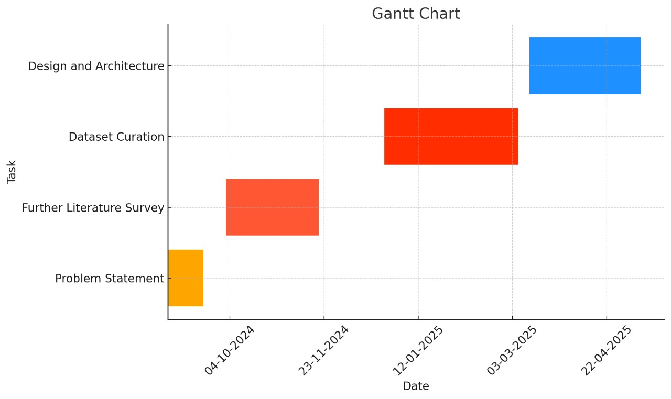
Capstone (Phase-I , Phase-II and Phase III) Project Timeline

Slide 23
Expected Deliverables
Capstone-I deliverables
Capstone-II deliverables
Capstone-III deliverables

Slide 24
CAPSTONE I - Deliverables
Literature survey
Identification of Problem Statement
Requirements Elicitation
Feasibility Study
Setting up a project timeline using Gantt chart
Creating a summary presentation of our idea

Slide 25
CAPSTONE II – DELIVERABLES
Acquiring/Creating relevant datasets
Choosing the appropriate software tools that will be used for the project
Creating a detailed workflow
Creating a prototype based on the datasets collected
High-Level Design

Slide 26
CAPSTONE III – DELIVERABLES
Refining the project prototype and aligning it with industry level standards.
Summing our project along with all the issues resolved that we had come up in Capstone phase II.
Working in the commercial aspect of our project.
Low-Level Design, Module wise implementation
Making a research paper on our project and publishing it.

Slide 27
Any other information
User Training: Educate the personnel who will be interacting with the CCTV system about the signs of replay attacks and how to respond to alerts.
Incident Response Plan: Develop a detailed incident response plan to handle detected replay attacks efficiently. This should include steps for isolating affected systems, investigating the breach, and mitigating the damage.
Redundancy and Backup: Implement redundancy in your CCTV infrastructure to ensure there is always a backup in case one system fails. Regular backups of footage can also help verify the integrity of the data.
Detailed Documentation: Maintain comprehensive documentation of the system design, protocols, and updates. This can help in troubleshooting and training new team members.
User Feedback Loop: Incorporate a feedback mechanism where users can report any false positives or system issues, which can be used to improve the AI model.

Slide 28
Conclusion
Our project addresses the critical security challenge posed by replay attacks in CCTV systems, a growing concern in modern surveillance infrastructure. By leveraging AI-powered anomaly detection, secure communication protocols, and real-time automated responses, our solution provides a robust defense mechanism to enhance surveillance reliability and integrity. The system's modular design allows seamless integration with existing infrastructures, ensuring adaptability and scalability for diverse use cases. With its focus on live real-time streaming, this project demonstrates the potential of advanced AI-driven techniques to safeguard sensitive environments and bolster public safety. It sets a strong foundation for future innovations in intelligent, adaptive security measures for an increasingly connected world.

Slide 29
References
[1] Seegehalli, P.J., Krupa, B.N. Lightweight 3D-StudentNet for defending against face replay attacks. SIViP 18, 6613–6629 (2024). https://doi.org/10.1007/s11760-024-03339-2
[2] S. Gargoum, N. Yassaie, A. W. Al-Dabbagh, and C. Feng, "A Data-Driven Framework for Verified Detection of Replay Attacks on Industrial Control Systems," IEEE Transactions on Automation Science and Engineering, pp. 1–13, 2024, DOI: 10.1109/TASE.2024.3394315.
[3] D. Zhao, B. Yang, Y. Li, and H. Zhang, "Replay Attack Detection for Cyber-Physical Control Systems: A Dynamical Delay Estimation Method," IEEE Transactions on Industrial Electronics, vol. 71, no. 6, pp. 6263-6273, Jun. 2024, doi: 10.1109/TIE.2024.3406859.
[4] R. Pichamuthu, S. A., and N. Khadirkumar, "An Enhanced Deep Learning Approach for Preventing Replay Attacks in Wireless Sensor Network," Solid State Technology, vol. 63, no. 4, pp. 8-22, 2020.

Slide 30
References
[5] A. Naha, A. Teixeira, A. Ahlén, and S. Dey, "Sequential Detection of Replay Attacks," IEEE Transactions on Automatic Control, vol. 68, no. 3, pp. 1247–1258, Mar. 2023. DOI: 10.1109/TAC.2022.1234567.
[6] A. Patel and M. Z. A. Khan, "Optimal Chi-squared Detector of Replay Attacks on Cyber-Physical Systems," in Proc. 2021 9th Int. Conf. Systems and Control (ICSC), Caen, France, 2021, pp. 338–343. DOI:10.1109/ICSC50472.2021.9666502.
[7] Y. Yu, W. Yang, W. Ding, and J. Zhou, "Reinforcement Learning Solution for Cyber-Physical Systems Security Against Replay Attacks," IEEE Transactions on Information Forensics and Security, vol. 18, pp. 2583–2594, 2023, doi: 10.1109/TIFS.2023.3268532.
[8] A. A. Elsaeidy, A. Jamalipour, and K. S. Munasinghe, "A Hybrid Deep Learning Approach for Replay and DDoS Attack Detection in a Smart City," IEEE Access, vol. 9, pp. 154864-154875, Nov. 2021, doi: 10.1109/ACCESS.2021.3128701.

Slide 31
Thank You

